Slide 1
Introduction
Tree based learning algorithms are considered to be one of the best and mostly used supervised learning methods.
• Tree based methods empower predictive models with high accuracy, stability and ease of interpretation.
• Unlike linear models, they map non-linear relationships quite well. They are adaptable at solving any kind of problem at hand (classification or regression)

Slide 2
What is a Decision Tree ?
Decision tree is a type of supervised learning algorithm (having a predefined target variable) that is mostly used in classification problems.
• It works for both categorical and continuous input and output variables.
• In this technique, we split the population or sample into two or more homogeneous sets (or sub-populations) based on most significant splitter / differentiator in input variables.

Slide 3
Important Terminology related to Decision Trees
• Root Node: It represents entire population or sample and this further gets divided into two or more homogeneous sets.
• Splitting: It is a process of dividing a node into two or more subnodes.
• Decision Node: When a sub-node splits into further sub-nodes, then it is called decision node.
• Leaf/ Terminal Node: Nodes do not split is called Leaf or Terminal node.

Slide 4
Pruning
• Pruning: When we remove sub-nodes of a decision node, this process is called pruning. You can say opposite process of splitting.
• Branch / Sub-Tree: A sub section of entire tree is called branch or subtree.
• Parent and Child Node: A node, which is divided into sub-nodes is called parent node of sub-nodes where as sub-nodes are the child of parent node.

Slide 5
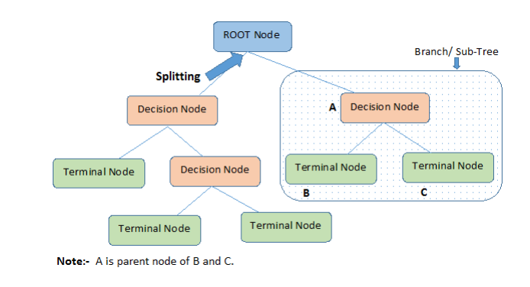

Slide 6
Advantages
Easy to Understand: Decision tree output is very easy to understand even for people from non-analytical background. It does not require any statistical knowledge to read and interpret them. Its graphical representation is very intuitive and users can easily relate their hypothesis.

Slide 7
Useful in Data exploration: Decision tree is one of the fastest way to identify most significant variables and relation between two or more variables. With the help of decision trees, we can create new variables / features that has better power to predict target variable.
It requires less data cleaning compared to some other modeling techniques.

Slide 8
• Data type is not a constraint: It can handle both numerical and categorical variables.
• Non Parametric Method: Decision tree is considered to be a nonparametric method. This means that decision trees have no assumptions about the space distribution and the classifier structure.

Slide 9
Disadvantages
• Over fitting: Over fitting is one of the most practical difficulty for decision tree models. This problem gets solved by setting constraints on model parameters and pruning (discussed in detailed below).
• Not fit for continuous variables: While working with continuous numerical variables, decision tree looses information when it categorizes variables in different categories.

Slide 10
Types of Decision Trees
1) Categorical Variable Decision Tree: Decision Tree which has categorical target variable then it called as categorical variable decision tree. Example:- In above scenario of student problem, where the target variable was “Student will play cricket or not” i.e. YES or NO.
2) Continuous Variable Decision Tree: Decision Tree has continuous target variable then it is called as Continuous Variable Decision Tree.

Slide 11
Example-
Let’s say we have a problem to predict whether a customer will pay his renewal premium with an insurance company (yes/ no).
Here we know that income of customer is a significant variable but insurance company does not have income details for all customers. Now, as we know this is an important variable, then we can build a decision tree to predict customer income based on occupation, product and various other variables. In this case, we are predicting values for continuous variable.

Slide 12
Regression Trees vs Classification Trees
Both the trees work almost similar to each other, let’s look at the primary differences & similarity between classification and regression trees:
Regression trees are used when dependent variable is continuous. Classification trees are used when dependent variable is categorical.
In case of regression tree, the value obtained by terminal nodes in the training data is the mean response of observation falling in that region. Thus, if an unseen data observation falls in that region, we’ll make its prediction with mean value.

Slide 13
• In case of classification tree, the value (class) obtained by terminal node in the training data is the mode of observations falling in that region. Thus, if an unseen data observation falls in that region, we’ll make its prediction with mode value.
• Both the trees divide the predictor space (independent variables) into distinct and non-overlapping regions. For the sake of simplicity, you can think of these regions as high dimensional boxes or boxes.

Slide 14
Both the trees follow a top-down greedy approach known as recursive binary splitting. We call it as ‘top-down’ because it begins from the top of tree when all the observations are available in a single region and successively splits the predictor space into two new branches down the tree. It is known as ‘greedy’ because, the algorithm cares (looks for best variable available) about only the current split, and not about future splits which will lead to a better tree.

Slide 15
This splitting process is continued until a user defined stopping criteria is reached. For example: we can tell the the algorithm to stop once the number of observations per node becomes less than 50.
In both the cases, the splitting process results in fully grown trees until the stopping criteria is reached. But, the fully grown tree is likely to overfit data, leading to poor accuracy on unseen data. This bring ‘pruning’. Pruning is one of the technique used tackle over fitting

Slide 16
How does a tree decide where to split?
The decision of making strategic splits heavily affects a tree’s accuracy. The decision criteria is different for classification and regression trees.

Slide 17
• Decision trees use multiple algorithms to decide to split a node in two or more sub-nodes. The creation of sub-nodes increases the homogeneity of resultant sub-nodes.
• In other words, we can say that purity of the node increases with respect to the target variable. Decision tree splits the nodes on all available variables and then selects the split which results in most homogeneous sub-nodes.

Slide 18
The algorithm selection is also based on type of target variables.
Let’s look at the four most commonly used algorithms in decision tree:

Slide 19
1) GINI
Gini says, if we select two items from a population at random then they must be of same class and probability for this is 1 if population is pure.
It works with categorical target variable “Success” or “Failure”.
It performs only Binary splits
Higher the value of Gini higher the homogeneity.
CART (Classification and Regression Tree) uses Gini method to create binary splits.

Slide 20
Steps to Calculate Gini for a split
• Calculate Gini for sub-nodes, using formula sum of square of probability for success and failure (p^2+q^2).
• Calculate Gini for split using weighted Gini score of each node of that split

Slide 21
2) Chi-Square
• It is an algorithm to find out the statistical significance between the differences between sub-nodes and parent node. We measure it by sum of squares of standardized differences between observed and expected frequencies of target variable.

Slide 22
It works with categorical target variable “Success” or “Failure”.
It can perform two or more splits.
Higher the value of Chi-Square higher the statistical significance of differences between sub-node and Parent node.
Chi-Square of each node is calculated using formula,
Chi-square = ((Actual – Expected)^2 / Expected)^1/2
It generates tree called CHAID (Chi-square Automatic Interaction Detector)

Slide 23
Steps to Calculate Chi-square for a split:
Calculate Chi-square for individual node by calculating the deviation for Success and Failure both
Calculated Chi-square of Split using Sum of all Chi-square of success and Failure of each node of the split

Slide 24

3) Entropy
Entropy can be calculated using formula:-
Here p and q is probability of success and failure respectively in that node. Entropy is also used with categorical target variable. It chooses the split which has lowest entropy compared to parent node and other splits. The lesser the entropy, the better it is.

Slide 25
Steps to calculate entropy for a split:
Calculate entropy of parent node
Calculate entropy of each individual node of split and calculate weighted average of all sub-nodes available in split.

Slide 26
4) Reduction in Variance
Till now, we have discussed the algorithms for categorical target variable. Reduction in variance is an algorithm used for continuous target variables (regression problems). This algorithm uses the standard formula of variance to choose the best split. The split with lower variance is selected as the criteria to split the population:

Slide 27
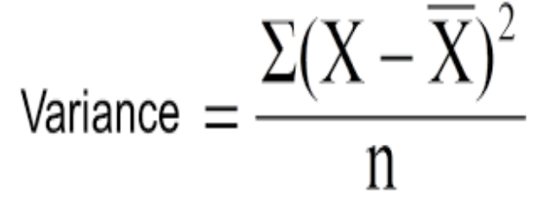
Here X-bar is mean of the values, X is actual and n is number of values
.

Slide 28
Steps to calculate Variance:
• Calculate variance for each node.
• Calculate variance for each split as weighted average of each node variance.

Slide 29
Information Gain:
Look at the image below and think which node can be described easily. I am sure, your answer is C because it requires less information as all values are similar. On the other hand, B requires more information to describe it and A requires the maximum information. In other words, we can say that C is a Pure node, B is less Impure and A is more impure.

Slide 30
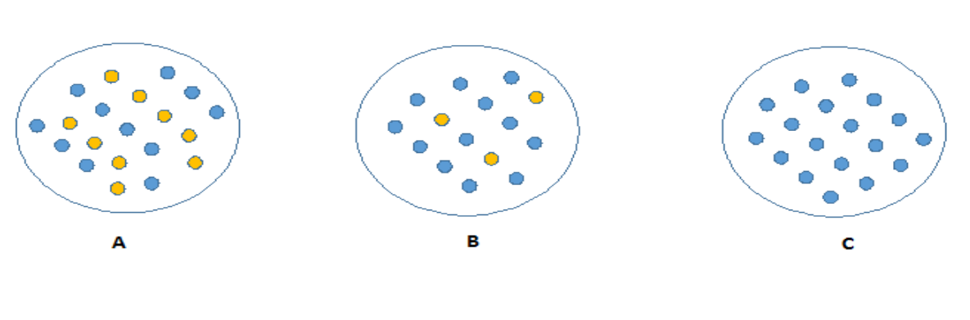

Slide 31
Now, we can build a conclusion that less impure node requires less information to describe it.
And, more impure node requires more information. Information theory is a measure to define this degree of disorganization in a system known as Entropy.
If the sample is completely homogeneous, then the entropy is zero and if the sample is an equally divided (50% – 50%), it has entropy of one.

Slide 32
What are the key parameters of tree modeling and how can we avoid over-fitting in decision trees?

Slide 33
Overfitting is one of the key challenges faced while modeling decision trees. If there is no limit set of a decision tree, it will give you 100% accuracy on training set because in the worse case it will end up making 1 leaf for each observation.
Thus, preventing overfitting is pivotal while modeling a decision tree and it can be done in 2 ways:
I. Setting constraints on tree size
II. Tree pruning

Slide 34
Setting Constraints on Tree Size
This can be done by using various parameters which are used to define a tree. First, lets look at the general structure of a decision tree:

Slide 35
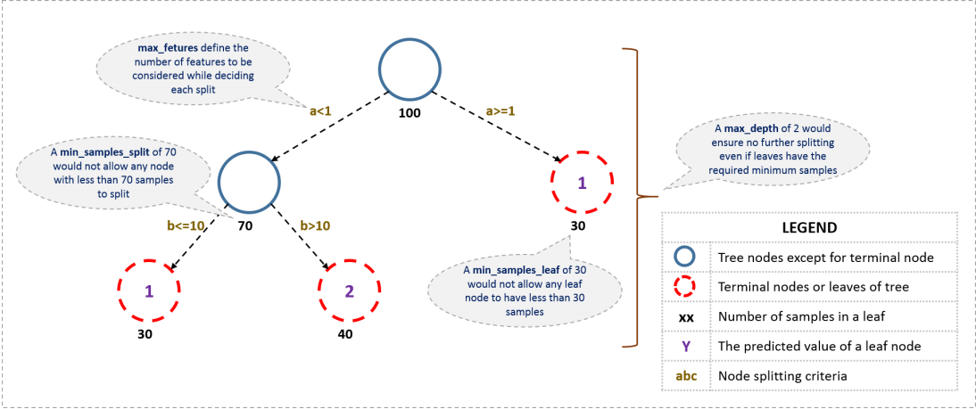

Slide 36
• The parameters used for defining a tree are further explained below. The parameters described below are irrespective of tool. It is important to understand the role of parameters used in tree modeling. These parameters are available in R & Python.

Slide 37
Minimum samples for a node split
• Defines the minimum number of samples (or observations) which are required in a node to be considered for splitting.
• Used to control over-fitting. Higher values prevent a model from learning relations which might be highly specific to the particular sample selected for a tree.
• Too high values can lead to under-fitting hence, it should be tuned using CV

Slide 38
Minimum samples for a terminal node (leaf)
• Defines the minimum samples (or observations) required in a terminal node or leaf.
• Used to control over-fitting similar to min_samples_split.
• Generally lower values should be chosen for imbalanced class problems because the regions in which the minority class will be in majority will be very small.

Slide 39
Maximum depth of tree (vertical depth)
• The maximum depth of a tree.
• Used to control over-fitting as higher depth will allow model to learn relations very specific to a particular sample.
• Should be tuned using CV.

Slide 40
Maximum number of terminal nodes
• The maximum number of terminal nodes or leaves in a tree.
• Can be defined in place of max_depth. Since binary trees are created, a depth of ‘n’ would produce a maximum of 2^n leaves.

Slide 41
Maximum features to consider for split
• The number of features to consider while searching for a best split. These will be randomly selected.
• As a thumb-rule, square root of the total number of features works great but we should check upto 30-40% of the total number of features.
• Higher values can lead to over-fitting but depends on case to case.

Slide 42
Are tree based models better than linear models?
“If I can use logistic regression for classification problems and linear regression for regression problems, why is there a need to use trees”? Many of us have this question. And, this is a valid one too.

Slide 43
Actually, you can use any algorithm. It is dependent on the type of problem you are solving.
Let’s look at some key factors which will help you to decide which algorithm to use:

Slide 44
• If the relationship between dependent & independent variable is well approximated by a linear model, linear regression will outperform tree based model.
• If there is a high non-linearity & complex relationship between dependent & independent variables, a tree model will outperform a classical regression method.
• If you need to build a model which is easy to explain to people, a decision tree model will always do better than a linear model. Decision tree models are even simpler to interpret than linear regression!

Slide 45
Pruning
We first make the decision tree to a large depth.
Then we start at the bottom and start removing leaves which are giving us negative returns when compared from the top.
Suppose a split is giving us a gain of say -10 (loss of 10) and then the next split on that gives us a gain of 20. A simple decision tree will stop at step 1 but in pruning, we will see that the overall gain is +10 and keep both leaves.

Slide 46
NOTE
Note that sklearn’s decision tree classifier does not currently support pruning. Advanced packages like xgboost have adopted tree pruning in their implementation.

